Slide 1


Slide 2
Overview
General Overview
Unit Description: Computer Organization is Topic 2 of the IB Computer Science course and is recommended to be taught over a minimum of 6 hours or 9-45 minute lessons and assessed over 2 lessons.
It is also a component of the course IB Digital Societies.
Computer Architecture | OS and Application Systems | Binary Representation
Simple Logic Gates

Slide 3
Motivation
Motivation for Unit
This is a lesson that may be used in IB Digital Societies and IB Computer Science. A unique component of IB classes is the requirement that all lessons must have elements of a core course called Theory of Knowledge and Approaches to Learning. In simplest terms, every lesson must ask require the student to write and reflect on the question of "how is this knowledge?" and "how do you know this is knowledge". The ATL component requires research and communication in every unit and lesson if possible.
This is a lesson that may be used in IB Digital Societies and IB Computer Science.
IB Lessons must have TOK Component and and ATL Component
.
Theory of Knowledge
How is this “knowledge”?
How do you validate “knowledge”?
.
Approaches to Learning
Research
Communication
Time Management

Slide 4
NYS Standards
9.12.NSD.1 Design a solution to a problem that utilizes embedded systems to automatically gather input from the environment.
9.12.NSD.2 Explain the levels of interaction existing between the application software, system software, and hardware of a computing system.
9.12.NSD.3 Develop and communicate multi-step troubleshooting strategies others can use to identify and fix problems with computing devices and their components.
9-12.NSD.4 Describe the components and design characteristics that allow data and information to be moved, stored and referenced over the Internet

Slide 5
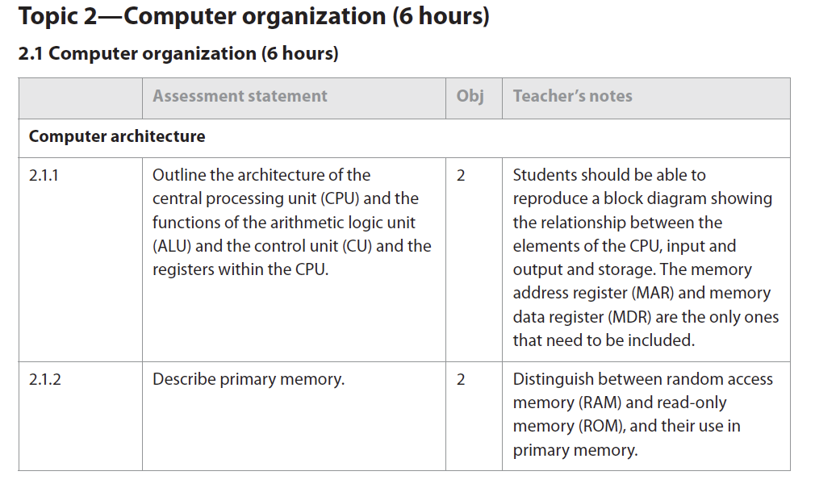
IB Standards
The IB Standards for the Unit on Computer Organization includes 13 specific standards that every student must be able to attain proficiency. IB standards align to the assessment and an example of 2.1.1 and 2.1.2 is shown below:

Slide 6
Andragogy
Andragogy v Pedagogy - andragogy = teaching to adult learners (16 - 19 year-old DP students)
IB DP students are considered emerging or early adults and the teaching approach is more andragogical than pedagogical.
Adult learners prefer to be responsible for their own learning and involved in the planning and evaluation of their instruction.

Slide 7

Teaching protocol
Harkness Teaching Protocol -
problem based learning protocol that emphasizes independent student work and discussion. The teacher is a facilitator and provides general questions for research and discussion by the students. Discussion and inquiry will be student centered and lessons will be concept based.

Slide 8
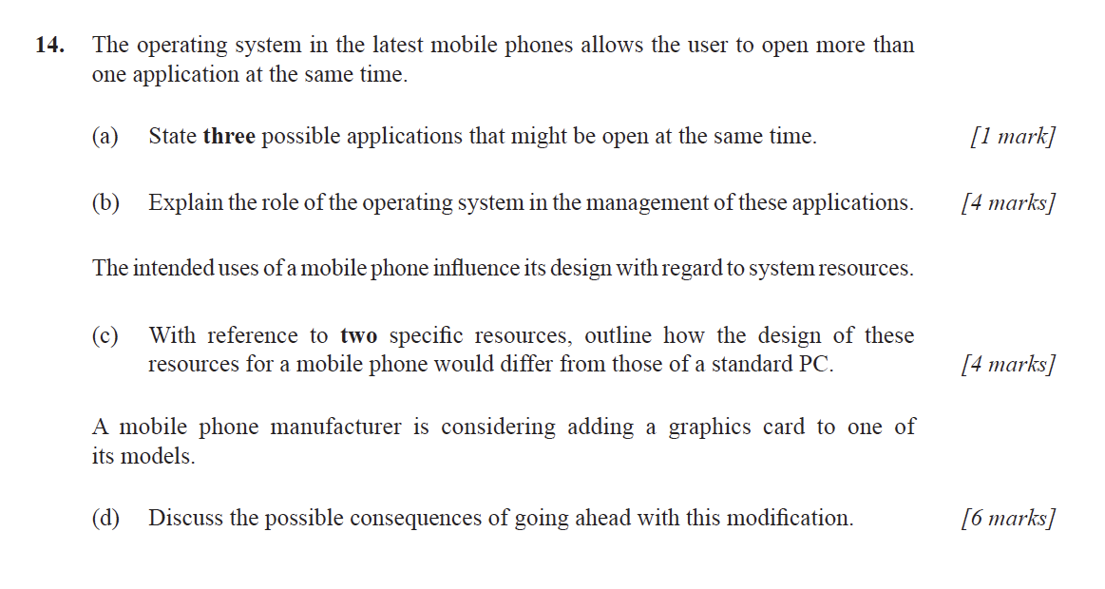
Specimen Assessment in ib

